Slide 1

Notes:
[54.0 - 108.0]

Slide 2
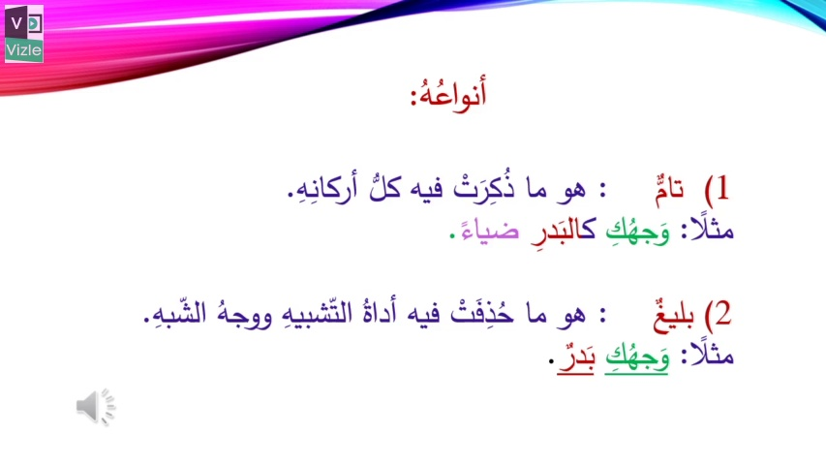
Notes:
[216.0 - 324.0]

Slide 3
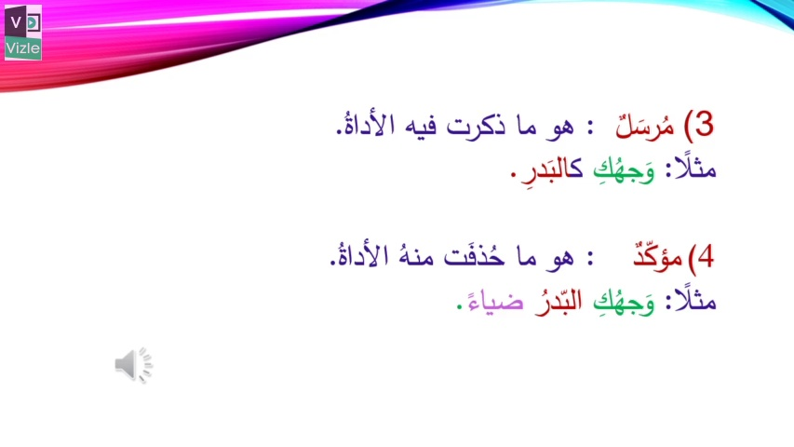
Notes:
[324.0 - 378.0]

Slide 4
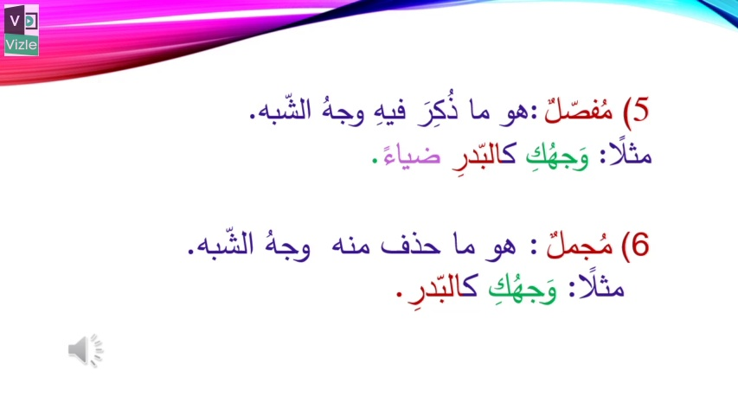
Notes:
[378.0 - 432.0]

Slide 5
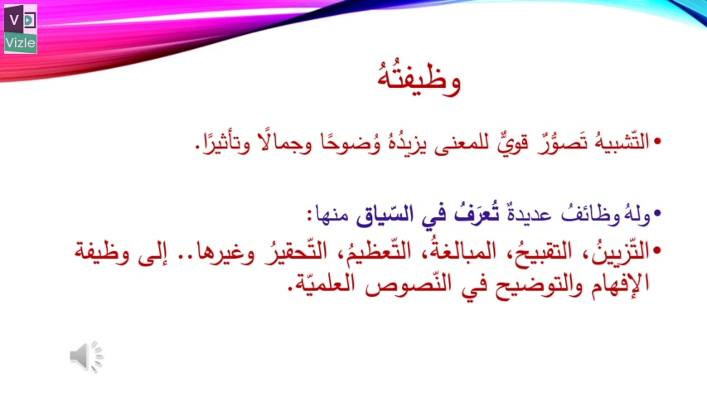
Notes:
[486.0 - 540.0]

Slide 6
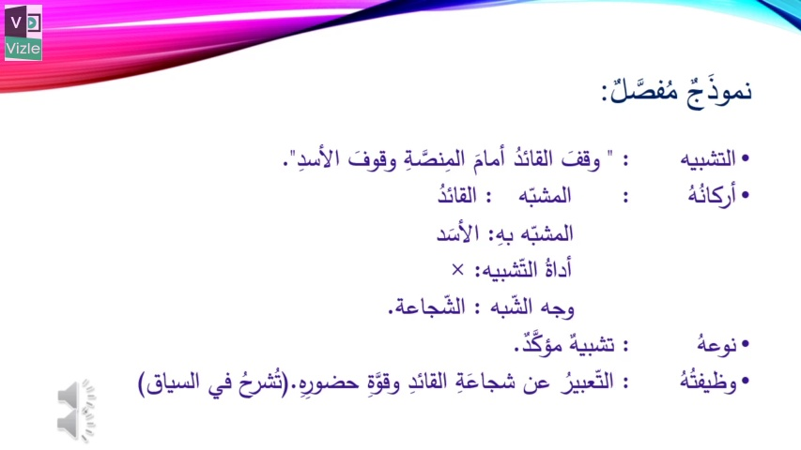
Notes:
[594.0 - 652.7]

